Slide 1

AGB1211 – DESIGN THINKING
Department of Artificial Intelligence and Data Science
Academic Year: 2024 – 2025 (Odd Semester)
Year : II
Semester : III
Section : B
Date : 6.12.2024
PRESENTED BY, GUIDED BY
1.SIBI CHAKKARAVARTHI S (2303811724321105) JOANY FRANKLIN M.E.,
2.SRIVATHSAN S (2303811724321108) Assistant Professor,
3.SUDHAKARAN M (2303811724321111) Department of AI,
K.Ramakrishnan College of Technology.

Slide 2

Title of the Project
BRING GENDER EQUALITY
IN WORKPLACE
2
AGB1211 – DESIGN THINKING

Slide 3
Problem Identification
Pay Gap: Women are often paid less than men for the same job.
Stereotypes: Traditional ideas about gender can unfairly judge women’s skills and leadership.
Lack of Policies: Many workplaces don’t have enough rules for fair pay,or parental leave.
Mental Health: Discrimination and feeling undervalued can cause stress and burnout.
Work-Life Balance: Women often handle more caregiving, limiting
3
AGB1211 – DESIGN THINKING

Slide 4
Objective
The objective of the Gender Equality in the Workplace project is to promote an inclusive and diverse work environment by eliminating gender disparities, ensuring equal opportunities, and creating supportive policies. It aims to raise awareness of gender bias, implement equitable practices such as equal pay and balanced leadership, and monitor progress through measurable goals. The project seeks to foster a culture of inclusivity where individuals of all genders have equal chances to succeed
4
AGB1211 – DESIGN THINKING

Slide 5
BrainStorming
Gender Equality Diversity and Inclusion Pay Equity
Implicit Bias
Workplace Culture Representation Leadership Diversity
Unconscious Bias Training
Parental Leave Policies Flexible Work Arrangements
Mentorship Programs Career Advancement Employee Advocacy Inclusive Policies Work-Life Balance Gender Stereotypes Transparency
Equal Opportunity Intersectionality Retention Strategies
AGB1211 – DESIGN THINKING

Slide 6
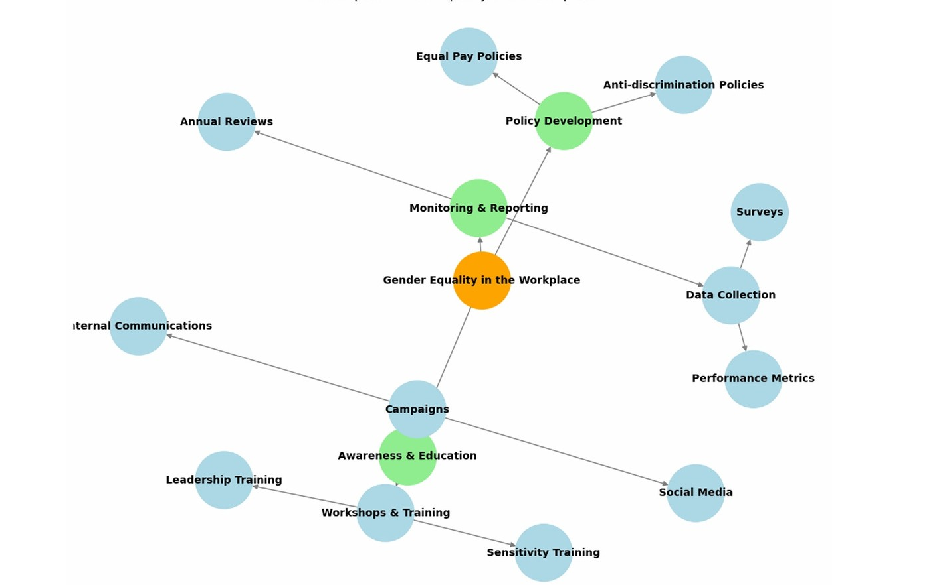
Mind Map
AGB1211 – DESIGN THINKING

Slide 7
Primary Research
Primary research involves collecting firsthand feedback. You can conduct surveys to understand people’s experiences with gender equality and interest in using an app. Interviews with experts help gather deeper insights into how an app could address issues like gender- based violence. Focus groups allow you to discuss app features with users, while user testing provides feedback on app design and functionality.
AGB1211 – DESIGN THINKING

Slide 8
Secondary Research
Secondary research involves reviewing existing data. Reports from UN Women or the World Economic Forum offer insights on global gender equality issues. Research articles help understand gender challenges and solutions, and analyzing existing apps reveals what works or is missing. Legal frameworks ensure the app follows gender equality laws, and market research shows the demand for such an app.
AGB1211 – DESIGN THINKING

Slide 9
Proposed Work
Empathize: Gather employee insights through surveys and interviews to understand gender-related challenges. Define: Identify key issues like pay gaps, bias, or lack of representation.
Ideate: Brainstorm solutions such as bias training, mentorship programs, and flexible policies.
Prototype: Test small-scale initiatives like pilot mentorships, transparent pay scales, or diversity workshops.
Test and Refine: Implement and refine solutions based on employee feedback.
Measure Progress: Track metrics like representation, pay equity, and employee satisfaction to ensure accountability.
9
AGB1211 – DESIGN THINKING

Slide 10
List of Modules
Understanding gender equality
Identifying and addressing gender bias
Building an inclusive work environment
Addressing the gender pay gap
Measuring progress and accountability
10

Slide 11



Module 1 Description
UNDERSTANDING GENDER EQUALITY :
Objective: Learn why gender equality is important in the workplace.
Topics: Benefits for productivity, innovation, and employee retention.
Outcome: Gain an understanding of the
importance of gender equality for organizations and society.
11

Slide 12
Module 2 Description
IDENTIFYING AND ADDRESSING GENDER BIAS:
Objective: Recognize and combat unconscious
gender bias.
Topics: Bias in hiring, performance evaluations, and promotions.
Outcome: Learn strategies to identify and reduce
bias in workplace process.
12

Slide 13



Module 3 Description (Cont..)
BUILDING AN INCLUSIVE WORK ENVIRONMENT :
Objective: Create a workplace that supports all
genders.
Topics: Gender-neutral policies, leadership roles, and promoting inclusivity.
Outcome: Learn how to build a culture of
inclusivity with supportive policies and systems.
13
AGB1211 – DESIGN THINKING

Slide 14

Module 4 Description
ADDRESSING THE GENDER PAY GAP AND CAREER ADVANCEMENT:
Objective: Close the gender pay gap and create equal career growth opportunities.
Topics: Pay audits, transparent salary structures, and career development.
Outcome: Learn strategies to ensure equal pay and promote career advancement for all genders.
14

Slide 15
Module 5 Description
MEASURING PROGRESS AND ACCOUNTABILITY :
Objective: Track gender equality progress and ensure accountability.
Topics: Key performance indicators (KPIs), feedback loops, and leadership roles in accountability.
Outcome: Learn how to measure and report progress on gender equality goals.
15

Slide 16
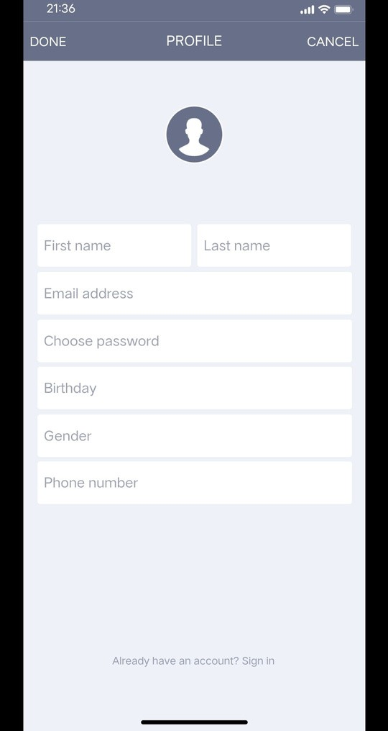
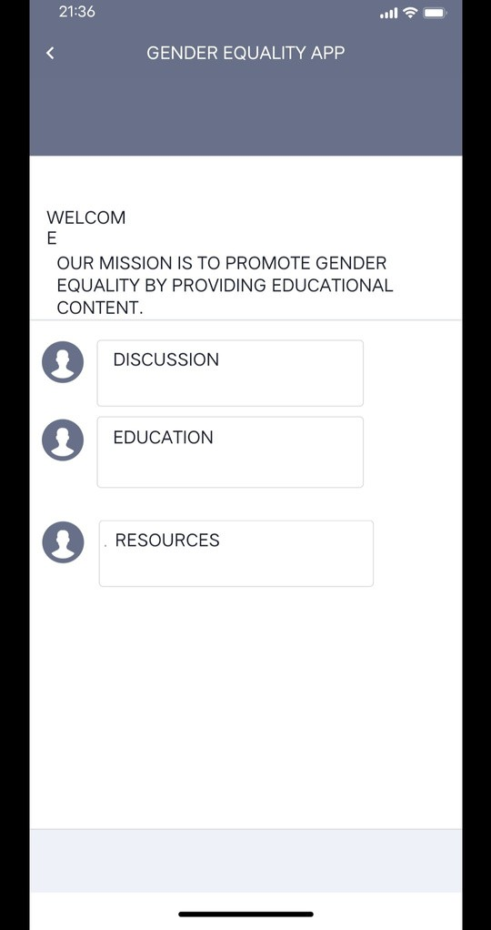
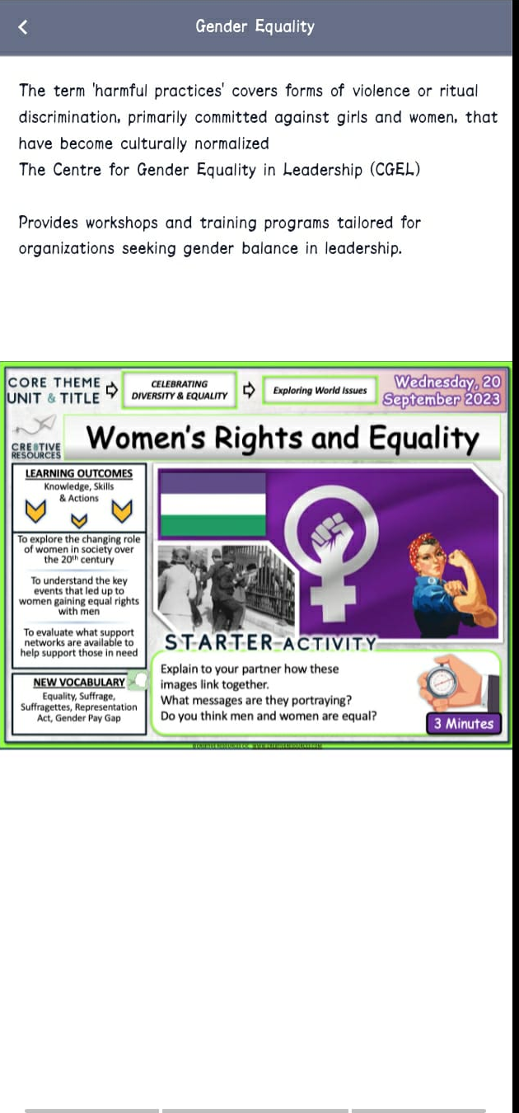
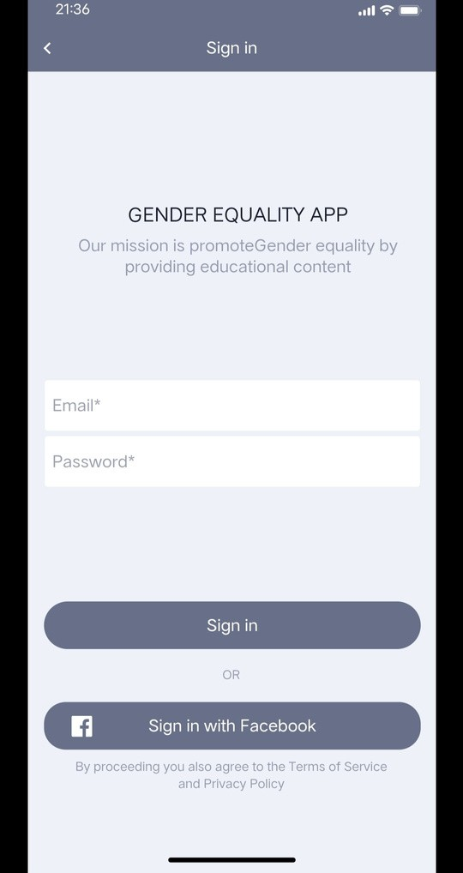
Results
screenshots
16
AGB1211 – DESIGN THINKING

Slide 17
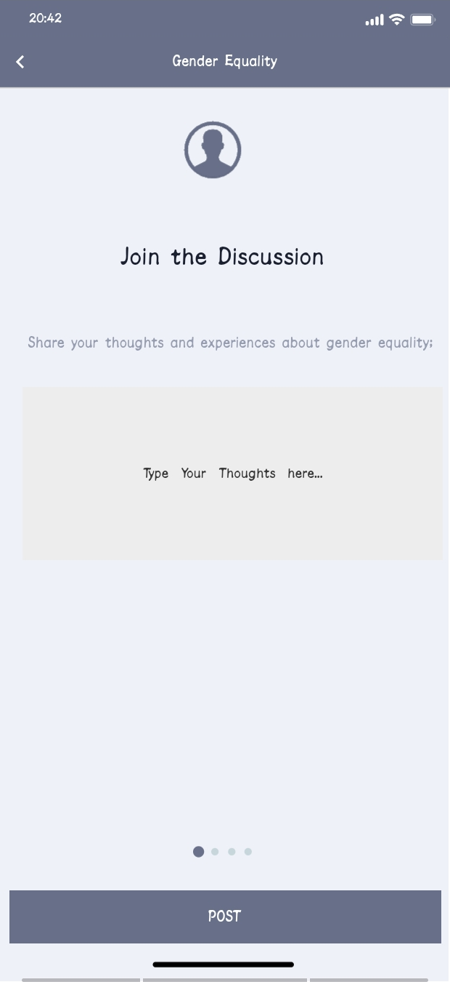
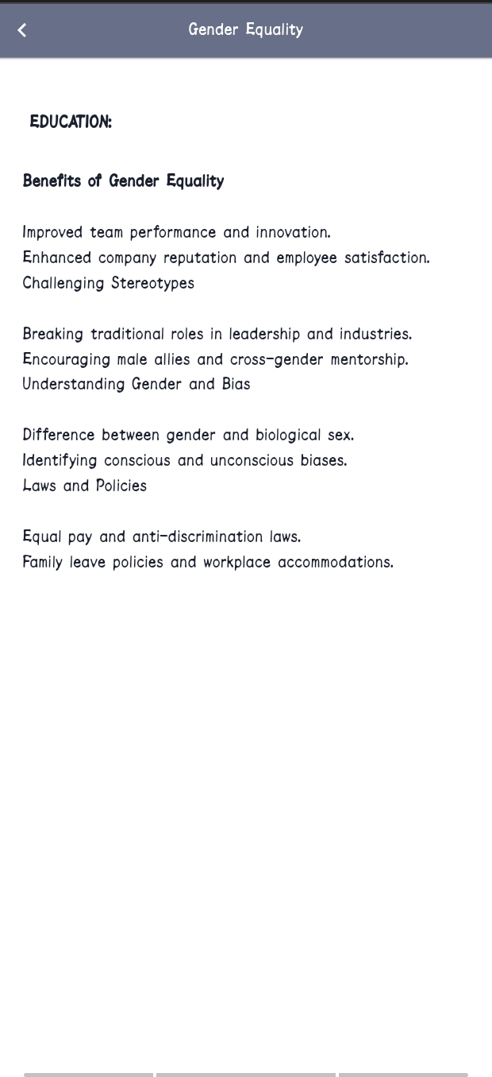
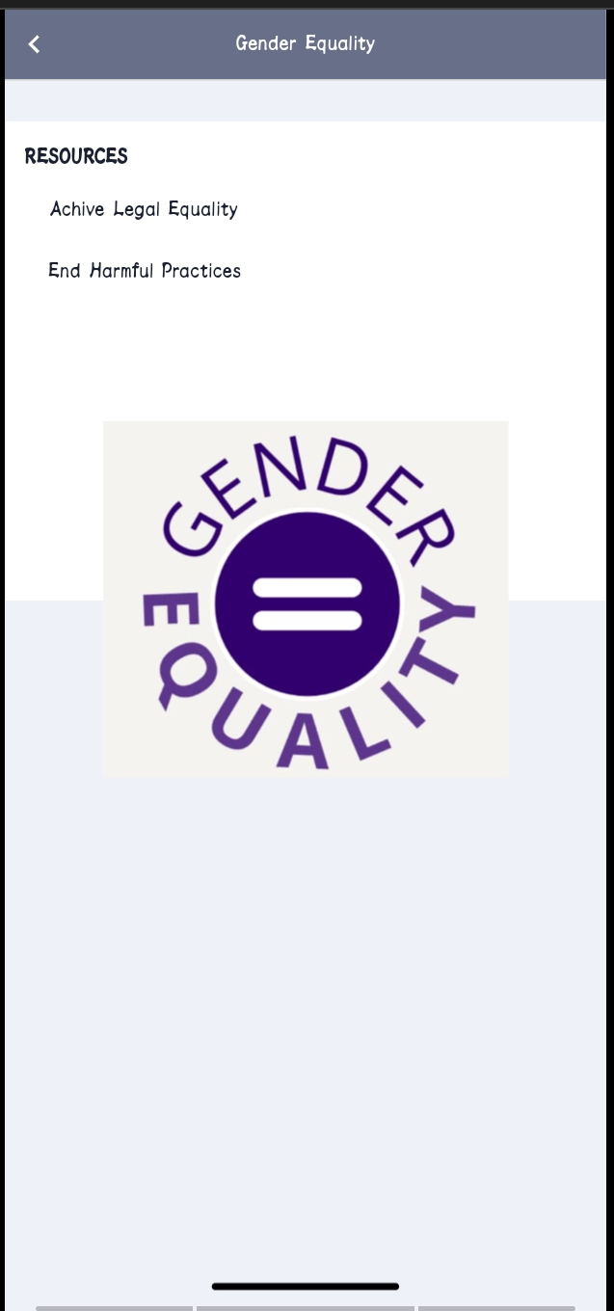
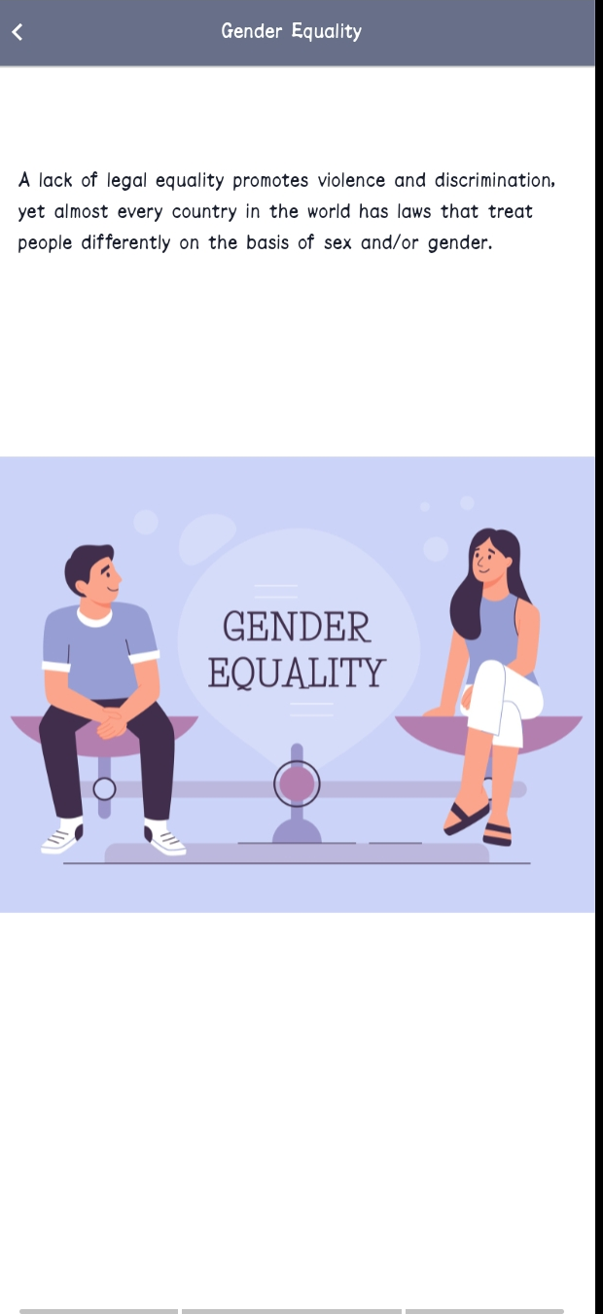
Results
screenshots
16
AGB1211 – DESIGN THINKING

Slide 18
Conclusion
A gender equality app for the workplace can help address important issues like pay equality, harassment, and career growth. It can offer tools for tracking salaries, reporting harassment, and providing resources for mentorship and training. The app can also promote workplace inclusivity by offering features like policy sharing, diversity tracking, and real-time feedback. By focusing on privacy and user engagement, the app can support both employees and organizations in creating a more equal and inclusive work environment.
18

Slide 19
Thank You
ANY QUERIES???
19

